Slide 1
Data Product Manager Nanodegree
Applying Data Science to Product Management
Project: Developing an MVP Launch Strategy for a Flying Taxi Service by Sérgio C. (PT)

Slide 2
Welcome to your first week at Flyber

Slide 3


Slide 4
In this project, you will apply the skills acquired in this course to create the MVP launch strategy for the first flying car taxi service, Flyber, in one of the most congested cities in America -- New York City.
You are responsible for bringing the first flying car taxi service to market by analyzing data and building a product proposal.

Slide 5
You will need to use the SQL workspace provided in the Classroom, and Tableau Public, in order to successfully complete the project.
You’ll present your answers, findings, and insights in the Answer Slides found in this deck. Feel free to include any additional slides, if needed.

Slide 6
Section 1: Data Exploration

Slide 7
Back to the basics of product management, identify your customer and their pain points:
What are taxis used for?
What are the characteristics of the users that leverage them?
What are existing pain points with taxis?
What are the existing pain points with digital ride-sharing services?

Slide 8
Answer Slide
To contextualize and better understand what we are talking about, I choose in my answers to give a broad perspective in the sense that in a way I compare the taxis-cab with the flying taxis.
What are taxis used for?
According to various sources and common sense, in general overview a taxi or taxicab, is a type of hire-pay vehicle with driver that can be used by a single passenger or a small group of passengers. Taxis transport passengers between locations of their choice, without specific timetables and regardless of geography. Unlike public transport where pick-up and drop-off locations are decided by the service provider, not by the customers/passengers. On a more specific level, flying taxis have a different purpose than what we are used to, as they can be seen as a very valid alternative to ordinary taxis that travel by land. They can present several advantages, both in terms of environmental issues, energy optimisation and, waste of time in road traffic. Additionally, considering these possible advantages, and analysing the traffic in large cities, one can assume that flying taxis will allow a better control of the customers' and operators' emotions.

Slide 9
Answer Slide
What are the characteristics of the users that leverage them?
Overall taxis-cab (and similar ones like uber) have several advantages over other types of transport in several aspects: - customers are usually use of this service out of necessity and there is no curiosity character; - they are fast compared to public transport; - they are private transports dedicated to a specific purpose (personal, professional, business or mixed); - they are characterised by transporting people end-to-end, considering and optimising the transport journey according to the passenger's needs, including amenities in the transport itself; - are characterised by a more personal and comfortable face for the customer; In the specific case of flying taxis, contrary to what I mentioned above, I can in an initial phase, the demand for this service is based more on exploration and curiosity of this service. But I believe that after an initial phase this service will be used in a more regular way, considering the aspects mentioned above, but including a better performance in all aspects.

Slide 10
Answer Slide
What are existing pain points with taxis?
Considering the current taxi service, we realize that regardless of the service quality it is , this always dependent on road traffic, and this is a really important point in this analysis, because as we will have the opportunity to see, in large cities traffic is chaotic, leading to a deterioration of the service provided. Besides that the service is often not provided with quality for several reasons among which I can highlight the personality of the taxi driver, the quality of the car in terms of aesthetics, maintenance and conservation as well as the gamma of the car. Others pain points regarding the service provided are the prices charged, the disorganization of the service provided, the lack of technology to interact with the service itself and facilitate prior communication between the passenger and the service provider. This factor is important because it greatly facilitates the service in terms of planning, organisation, route optimisation, etc..., even because the clients are looking for a service which is easy and quick to use. A downside and questionable issue for flying taxis could be obtaining licenses and state regulation. This service is rare for short trips at the local level. This may be an issue to consider at an early stage.

Slide 11
Answer Slide
What are the existing pain points with digital ride-sharing services?
Looking at some taxi service providers (example), one can see that the negative reviews I found online are mostly related to traffic issues / non-optimised routes as well as poor customer service.

Slide 12
What user improvements do you hypothesize a flying taxi service would have over the existing state of taxis today?
What market improvements do you hypothesize a flying taxi service would have the existing taxi service industry & physical road infrastructure today?

Slide 13
Answer Slide
What user improvements do you hypothesize a flying taxi service would have over the existing state of taxis today?
I can identify N improvements that such a service can bring to its customers. Among which I highlight: - ease of contracting the flying taxi service and the ease of travelling in comfort - travel with comfort and quality - guarantee of arriving on time at the destination - more competitive prices in a second phase - low air traffic - avoidance of ground traffic (including road accidents, traffic signs, during peak periods, etc) by considering air traffic rules. - possibility to automate driving (avoiding who knows which drivers)

Slide 14
Answer Slide
What market improvements do you hypothesize a flying taxi service would have the existing taxi service industry & physical road infrastructure today?
On the level of market improvements, we can also consider some aspects that are inevitably very good: - Although in some states the authorization for flying cars (like drones, ...) already exists de facto, the air traffic is considered to be too low for flying taxis. And NYC, it is considered that traffic is too low as well. - With the inclusion of flying taxis in the market, it is also inevitable that the traffic on NYC roads will decrease, because people will seek this service to reach their destinations (avoiding taking their car, renting cars or using ground transportation services like public transportation, taxis, ubers, etc...). - start transporting people between cities, with route optimisation - at an environmental level, consider reducing noise pollution caused by ground traffic, as well as using more sustainable technologies.

Slide 15
Answer Slide
Referencies: [1] – The flying taxi market may be ready for takeoff, changing the travel experience forever [2] – The air taxi market prepares to take flight [3] – Flying Taxi Market - Global Industry Analysis, Size, Share, Growth, Trends, and Forecast, 2021-2031 [4] – Uber reportedly will sell its flying taxi business to secretive startup Joby Aviation

Slide 16
Upload this dataset into Tableau Online.
Ensure the fields are parsed correctly; field headers are included in the first row of the CSV. Let’s begin exploration!

Slide 17
Acquire a high-level understanding of the granularity and scope of the dataset, to inform the basis for your analyses:
How many records are in the dataset
What does each record represent?
What is the primary key?
What date range is your dataset bound to?
What are the geographical bounds of this dataset? Is it limited to Manhattan, or is Brooklyn, Queens, Staten Island, the Bronx, and New Jersey included? Where are most of the data points centralized at? Are there outliers?

Slide 18
Answer Slide
You can find the tableau page here. You can validate the analyses that have been performed and the dashboards defined for the analysis. Other sources of this data and analysis: - Kaggle - Medium - Springer - Data cityofnewyork

Slide 19
Answer Slide
How many records are in the dataset The total number of records in dataset is 1,048,468 Each record represents a taxi ride!

Slide 20
Answer Slide
What does each record represent? Each record represents details of each taxi ride that occurs in NYC. These are (Kaggle):
id - a unique identifier for each trip vendor_id - a code indicating the provider associated with the trip record pickup_datetime - date and time when the meter was engaged dropoff_datetime - date and time when the meter was disengaged passenger_count - the number of passengers in the vehicle (driver entered value) pickup_longitude - the longitude where the meter was engaged pickup_latitude - the latitude where the meter was engaged dropoff_longitude - the longitude where the meter was disengaged dropoff_latitude - the latitude where the meter was disengaged store_and_fwd_flag - This flag indicates whether the trip record was held in vehicle memory before sending to the vendor because the vehicle did not have a connection to the server - Y=store and forward; N=not a store and forward trip duration - (target) duration of the trip in seconds distance - distance of the trip in meters

Slide 21
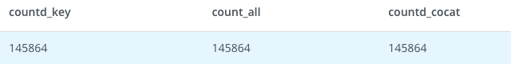
Answer Slide
What is the primary key?
The primary key for this dataset is {id} - Is a unique identifier for each trip. id is unique across the dataset, and is sufficient to be the primary key QUERY: SELECT COUNT(DISTINCT ID) as countd_key, COUNT(*) as count_all, count(distinct(concat (id,pickup_datetime))) as countd_cocat FROM taxi_rides

Slide 22
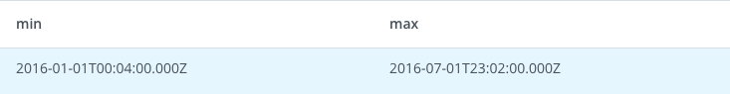
Answer Slide
What date range is your dataset bound to? Considering the dataset, the date range can be delimited by two dates: PickUp_Datetime and DropOff_Datetime. This means that a taxi cab trip starts when the passenger gets into the taxicab (PickUp_Datetime) and ends when the passenger gets out of the taxicab (Dropoff_Datetime). So we can do an analysis between the minimum PickUp_Datetime and the maximum DropOff_Datetime in the dataset. By analysis, the data is considered to be between January 2016 and July 2016 (01-07) QUERY:
select min(pickup_datetime ), max(dropoff_datetime) from taxi_rides

Slide 23
Answer Slide
What are the geographical bounds of this dataset? Is it limited to Manhattan, or is Brooklyn, Queens, Staten Island, the Bronx, and New Jersey included? Where are most of the data points centralized at? Are there outliers?

Slide 24
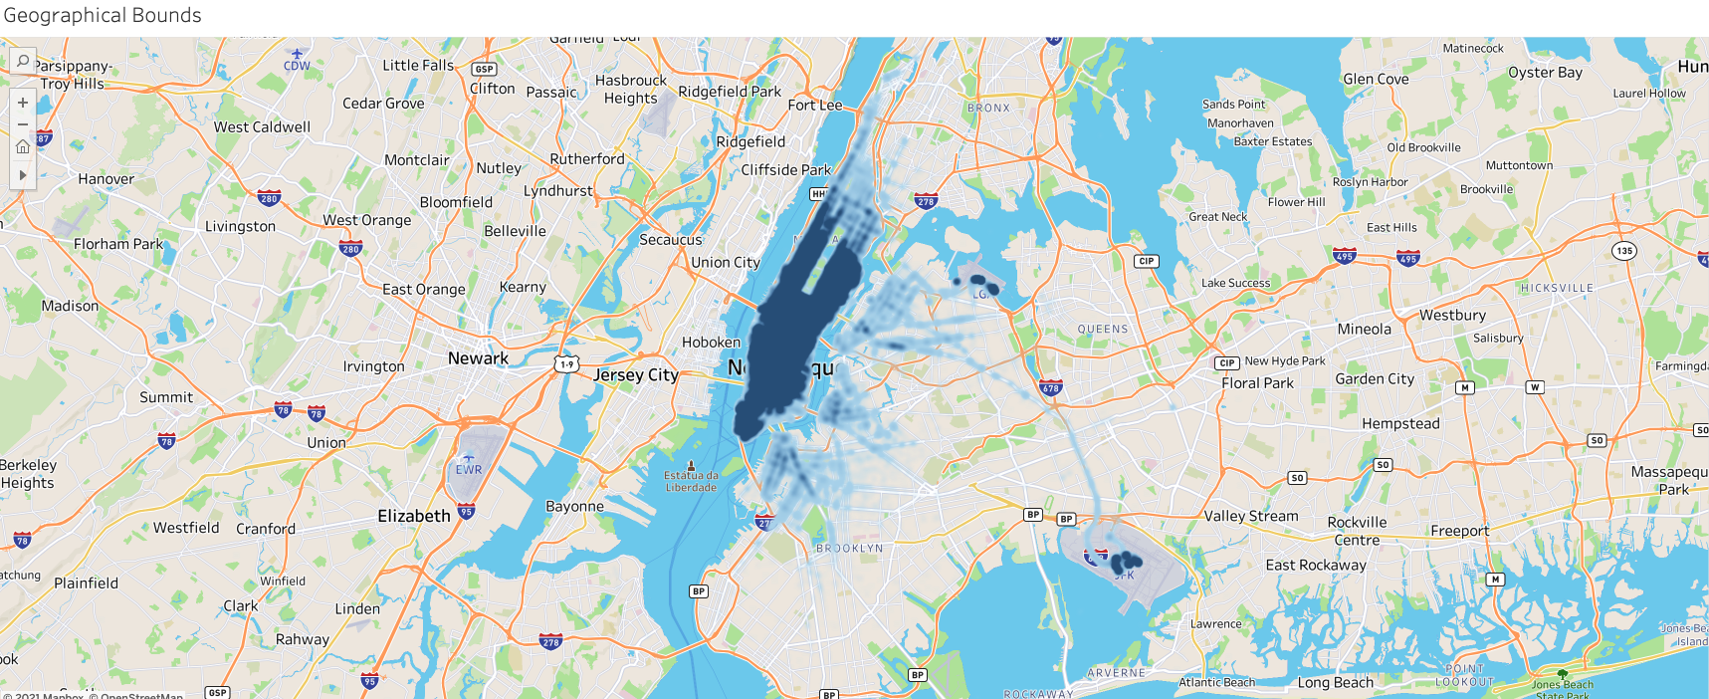
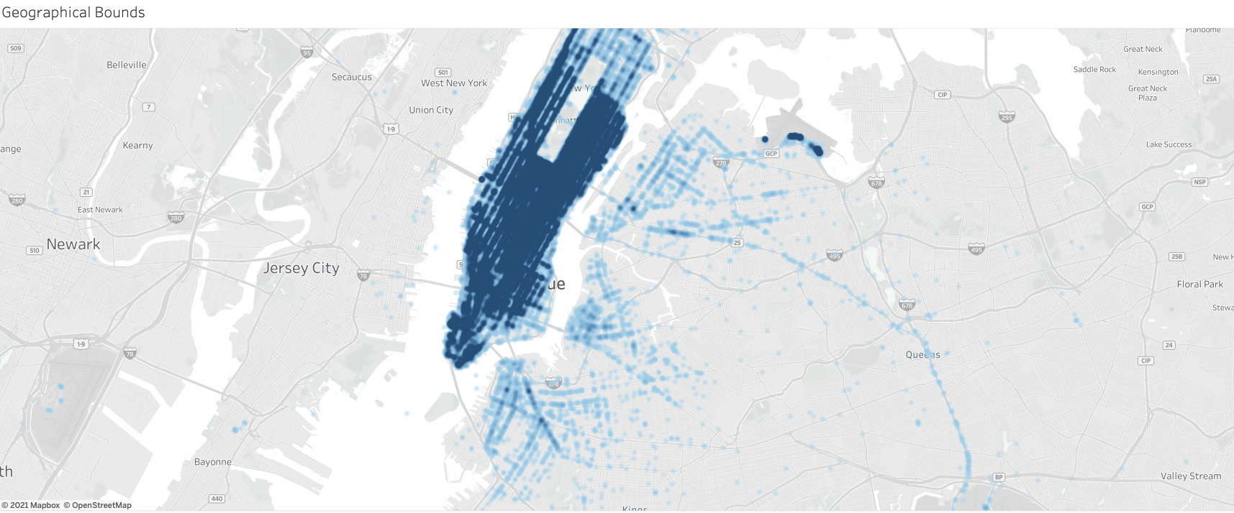
Answer Slide
The geographical bounds of this specific dataset is mostly focused within New York, specifically within NYC. Primarily Manhattan, some representation in the west side of Brooklyn and a very small piece of eastern New Jersey It is quite obvious that the core operation takes place in NYC.

Slide 25
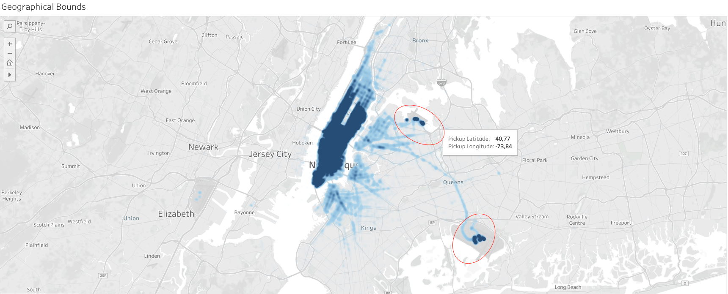
Answer Slide
I can see from the images on the map the density of data in certain geographies, namely within NYC. There are also some outliers (both La-Guardia and JFK), as we can see in the following image:

Slide 26
You notice that the dataset does not contain explicit data points out-of the-box, we’ll need to enrich the dataset with relevant fields:
You notice that ride price is not included, but figure it could be derived. Based on information about New York taxi prices gleaned from the internet, create a calculated field called `price` using the `duration`, `distance`, and `passenger count` fields.
You hypothesize your target users will be those who take a relatively longer time getting to a destination that is relatively close, due to heavy traffic conditions and/or limitations to physical road infrastructure. To be able to analyze where this is happening, you will need to create a calculated field called `distance-to-duration ratio`.

Slide 27
Answer Slide
Based on information about New York taxi prices gleaned from the internet, create a calculated field called `price` using the `duration`, `distance`, and `passenger count` fields.
Based on the following resources (Taxi Fare and Taxi-Calculator and Info) I looked for the definition of a calculation formula to determine the price of the trip. I considered not to use the number of passengers, because it should not influence the price of the trip. It is important to point out that we considered the variables duration in seconds and distance in km. So based on the information obtained, we consider that - The basic fee is $2.50, the kilometer price is $1.56. For standing and waiting time, $30.00 is charged per hour. So, the calculation formula is as follows (ignore waiting times per hour): Price = Base fee + (Cost per minute * time in ride) + (Cost per km * ride distance/0.62137119223733)

Slide 28
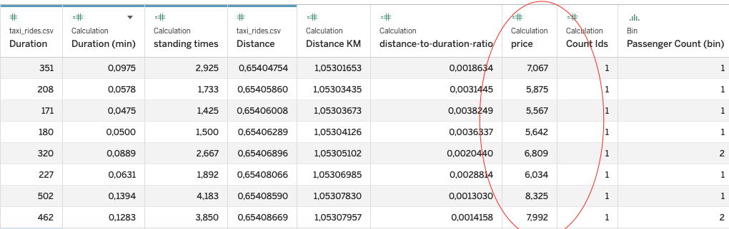
Answer Slide
Price = 2,50+ (1,56 * Distance / 0.6214)

Slide 29
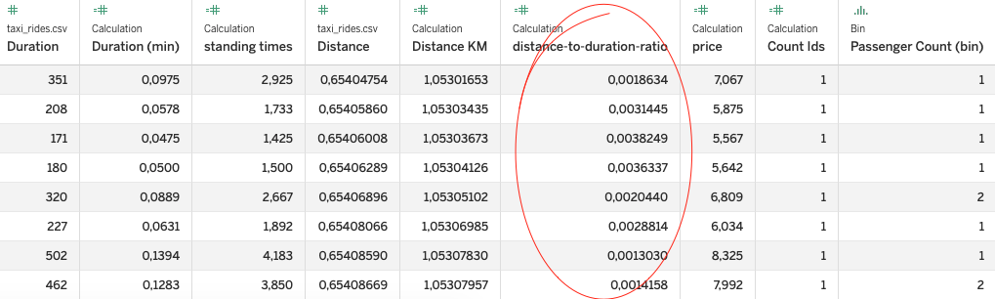
Answer Slide
To be able to analyze where this is happening, you will need to create a calculated field called `distance-to-duration ratio`.
distance-to-duration ratio = distance / duration

Slide 30
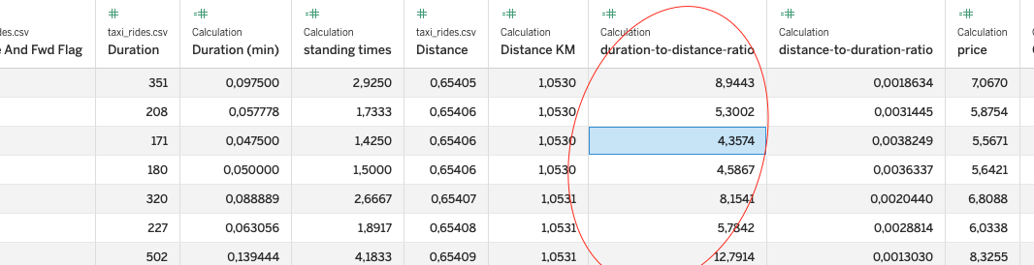
Answer Slide
duration-to-distance-ratio = IIF([Distance]>0.1 AND [Distance]<1000 AND [Duration]>59 AND [Duration]<=86060, [Duration]/([Distance]*60),0)

Slide 31
Let’s understand the scope and distribution various dimensions within the dataset. Calculate the average, median, and the first & second standard deviation of the mean for the following measures:
duration
distance
passenger counts
duration-to-distance ratio
price

Slide 32
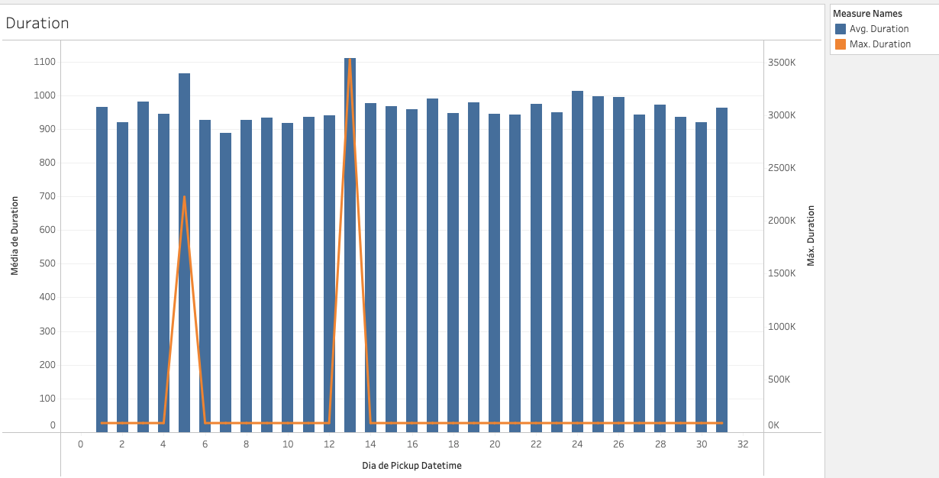
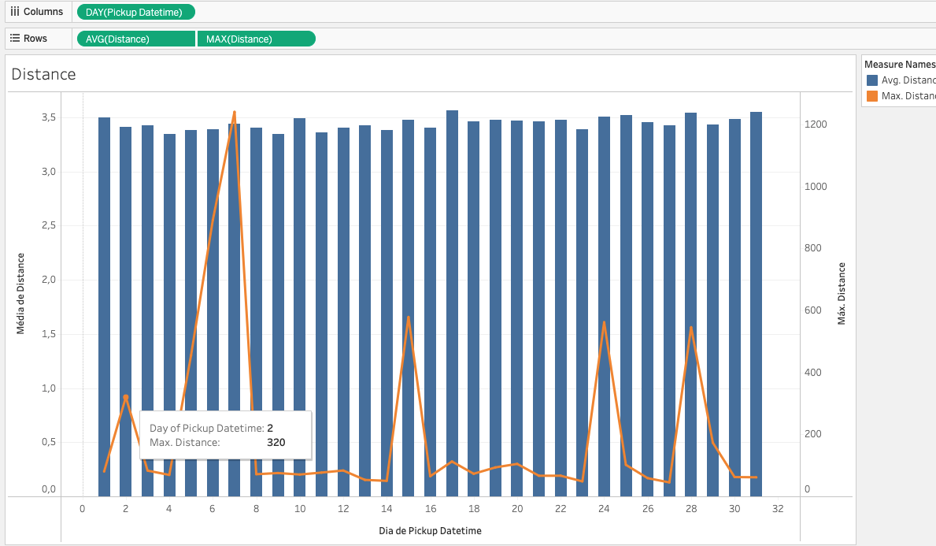
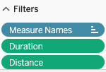
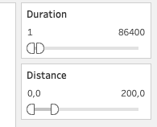
Answer Slide
Data Cleaning
I need to perform some amount of data cleaning, to remove the outliers above.
Apply filters
Duration: duration < 86400s
Distance: distance < 200 miles

Slide 33
Answer Slide
Using the tableau, we obtained the big picture of the pre-calculated metrics and the calculated metrics.
Measure (unit) | Aggregation type | Average | Median | First standard deviation of the mean | Second standard deviation of the mean
Duration (seconds) | 952,9 | 662,0 | 3.176,6 | 6.353,3
Distance (miles) | 3,437 | 2,095 | 3,956 | 7,913
Passenger counts (#persons) | 1,66 | 1,00 | 1,31 | 2,63
Duration-to-distance ratio (miles/sec) | 6,12 | 4,63 | 34,85 | 69,7
Price ($ dolars) | 19,1 | 13,5 | 29,7 | 59.5

Slide 34
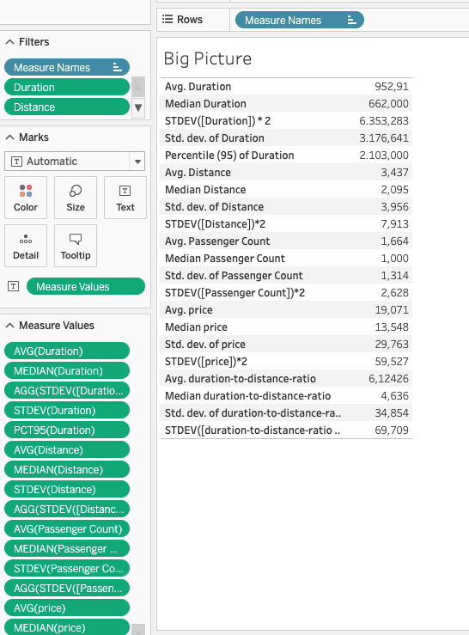
Answer Slide
Using the tableau, we obtained the big picture of the pre-calculated metrics and the calculated metrics.

Slide 35
Flying cars may have to have to be a lower weight for efficiency & take-off. Or you may just decide to leverage mini-copters for your initial MVP.
Create a histogram that visualizes the number of total rides grouped by passenger counts to analyze the potential market volume of low passenger pickups (1-2 passengers).

Slide 36
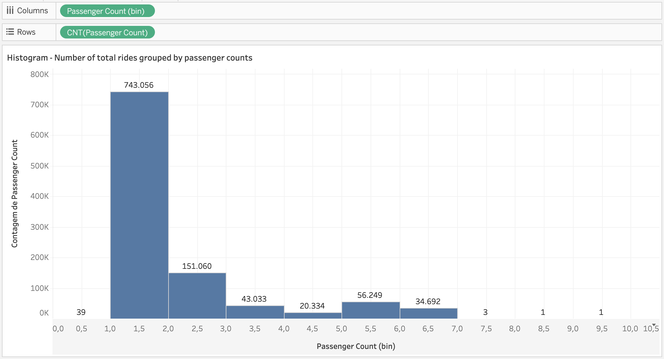
Answer Slide
I can check the total number of trips grouped by passenger, and it can be seen that there is great potential in 1 and 2 passenger trips, with the highest volume of trips in the historical data.

Slide 37
For the initial MVP launch (& most likely GA), we have a finite amount of monetary resources to build Flyber pick-up / drop-off nodes. We’ll need to be strategic on where we’ll place them:
Which neighborhoods/zip codes tends to experience a relatively higher density of pick-ups?
Which neighborhoods/zip codes tends to experience a relatively higher density of drop-offs?
Which neighborhoods/zip codes tends to have the highest duration-to-distance ratios, based on pick-up?
Which neighborhoods/zip codes tends to have the highest duration-to-distance ratios, based on drop-off?
For any of the neighborhoods identified, are there any potential areas within the neighborhood that are optimal for flying taxi pick-up / drop-off? What makes them suitable?

Slide 38
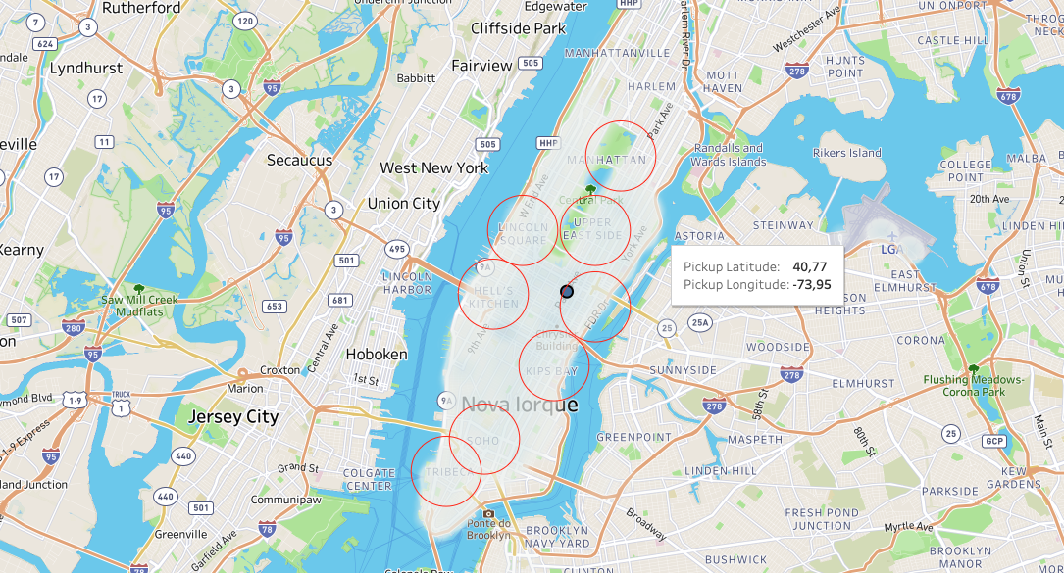
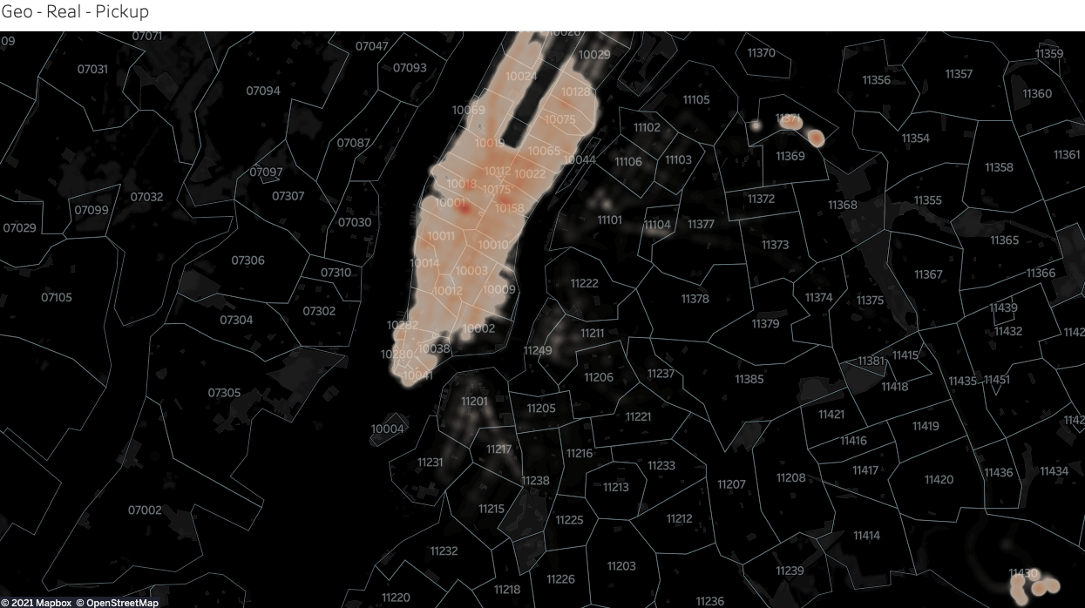
Answer Slide
Which neighborhoods/zip codes tends to experience a relatively higher density of pick-ups? Neighborhoods with the highest densities of pickups like: Alphabet City, Tribeca, Kips Bay, Upper Westside, Yorkville, Hell’s Kitchen, Yorkville, Upper Eastside and parts of Battery Park City; Zipcodes with the highest densities of pickups in map.

Slide 39
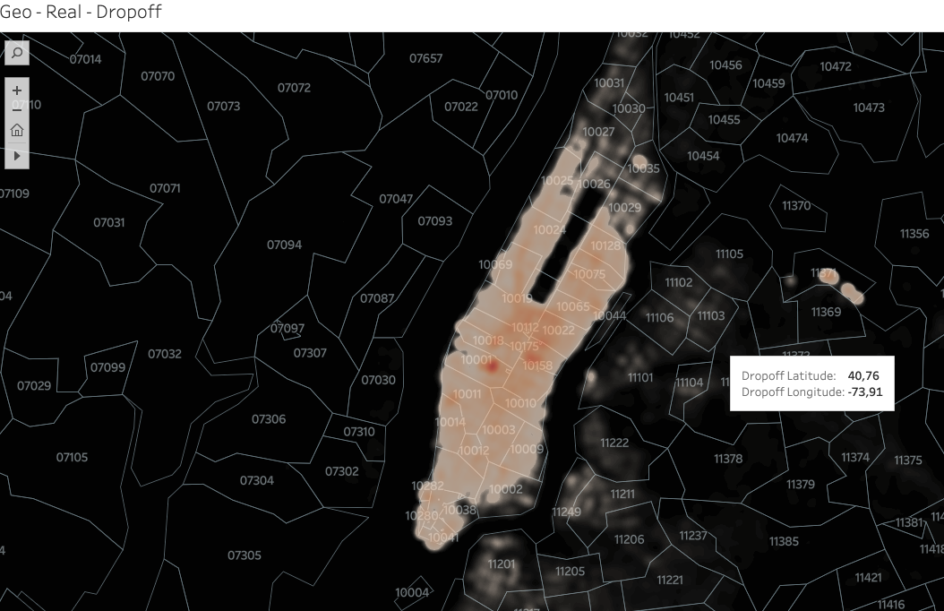
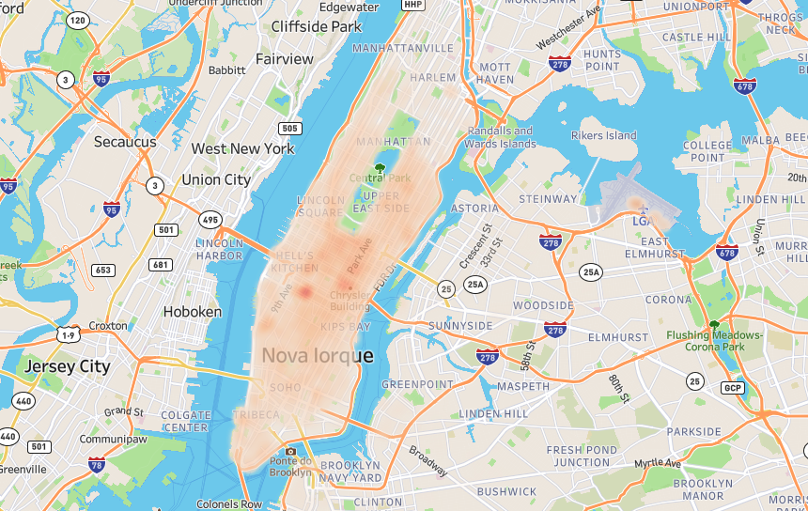
Answer Slide
Which neighborhoods/zip codes tends to experience a relatively higher density of drop-offs? Neighbourhoods with the highest densities of drop-offs like: Alphabet City, Tribeca, Kips Bay, La Guardia, Upper Westside, Hell’s Kitchen, Upper Eastside, Lincoln Square, Morningside Heights; Zipcodes with the highest densities of drop-offs in map. Drop-offs can be are more evenly distributed than pick-ups. However, South, Southeast, & East of Central Park are especially dense.

Slide 40
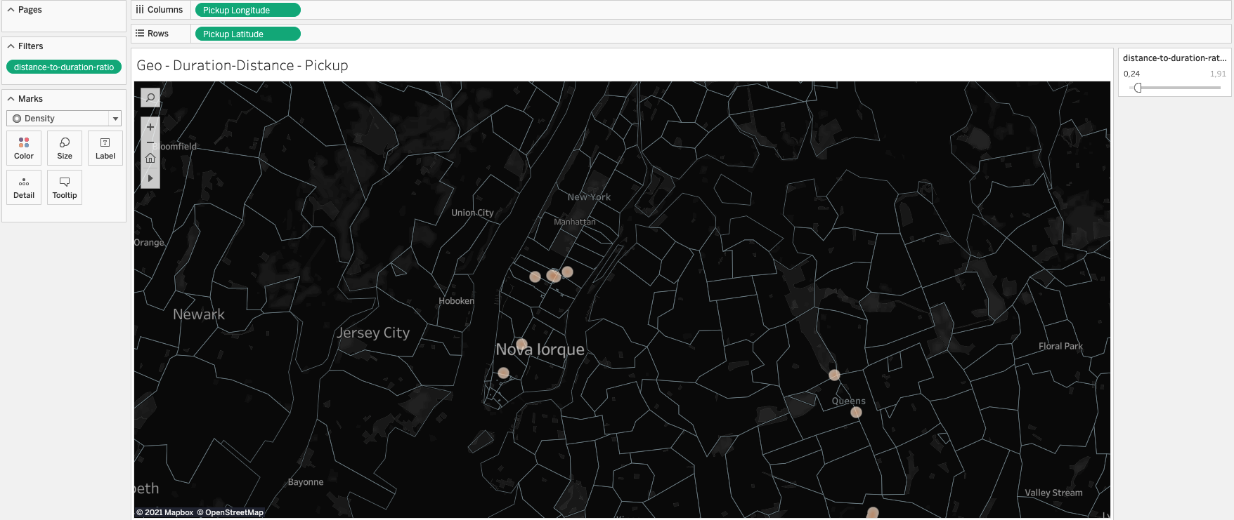
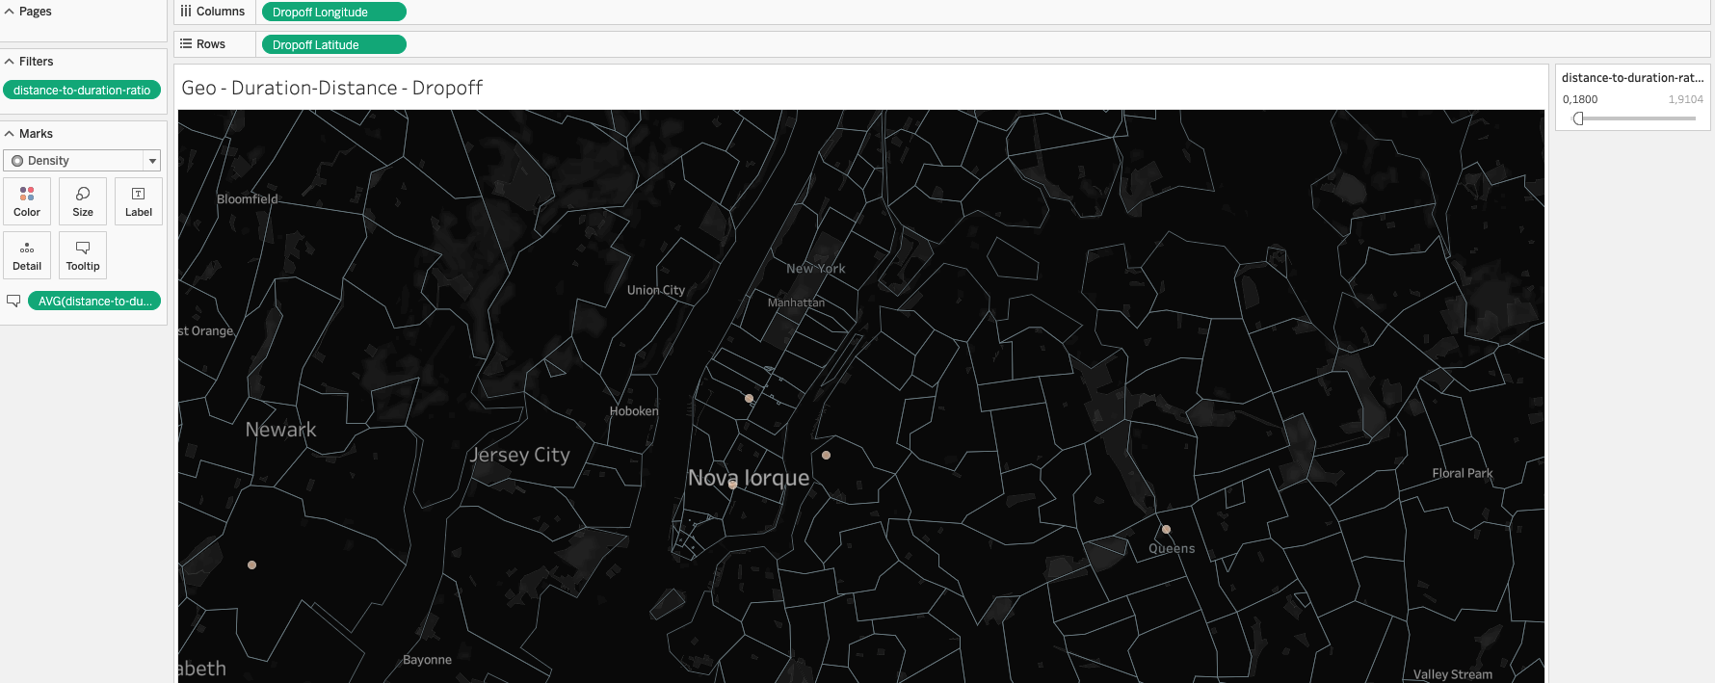
Answer Slide
Which neighborhoods/zip codes tends to have the highest duration-to-distance ratios, based on pick-up and drop-off?
based on pick-up: 10119 and 10121 west of Herald Square and 10018 east of Hell’s Kitchen
based on drop-off: 10119 and 10121 west of Herald Square, 10018 east of Hell’s Kitchen and (10165, 10174 and 10170) southeast of Diamond

Slide 41
Answer Slide
For any of the neighborhoods identified, are there any potential areas within the neighborhood that are optimal for flying taxi pick-up / drop-off? What makes them suitable? On the basis of the analyses carried out previously, and at a very high level, we can see that there is a high incidence at certain points. It is important to ensure geographically distinct zones, in the north and in the south. Assuming this way as potential zones of success the 10282 to the south and 16171 to the north. I cannot neglect airports, which are zones with high traffic frequency of people who need this type of services. This analysis needs a more detailed perspective in order to understand which periods of time and days have more incidence of demand. I hope to perform this analysis in the future analysis.

Slide 42
It may not make operational sense to have the service running 24/7, for now.
What times throughout the day experience relatively higher volumes of ride pick-ups?
What days throughout the week experience relatively higher volumes of ride pick-ups?
Pinpoint any periods throughout the year that experience trend fluctuation or seasonality around ride pick-up volumes. This will help us in our post-launch analyses to determine if any spikes or dips were influenced by seasonality or through actual feature adoption/regression.

Slide 43
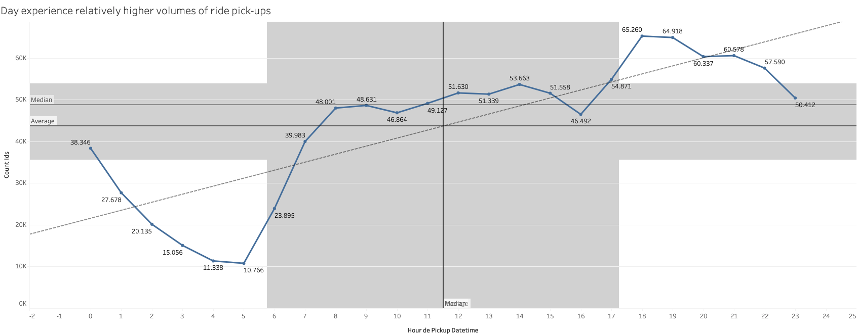
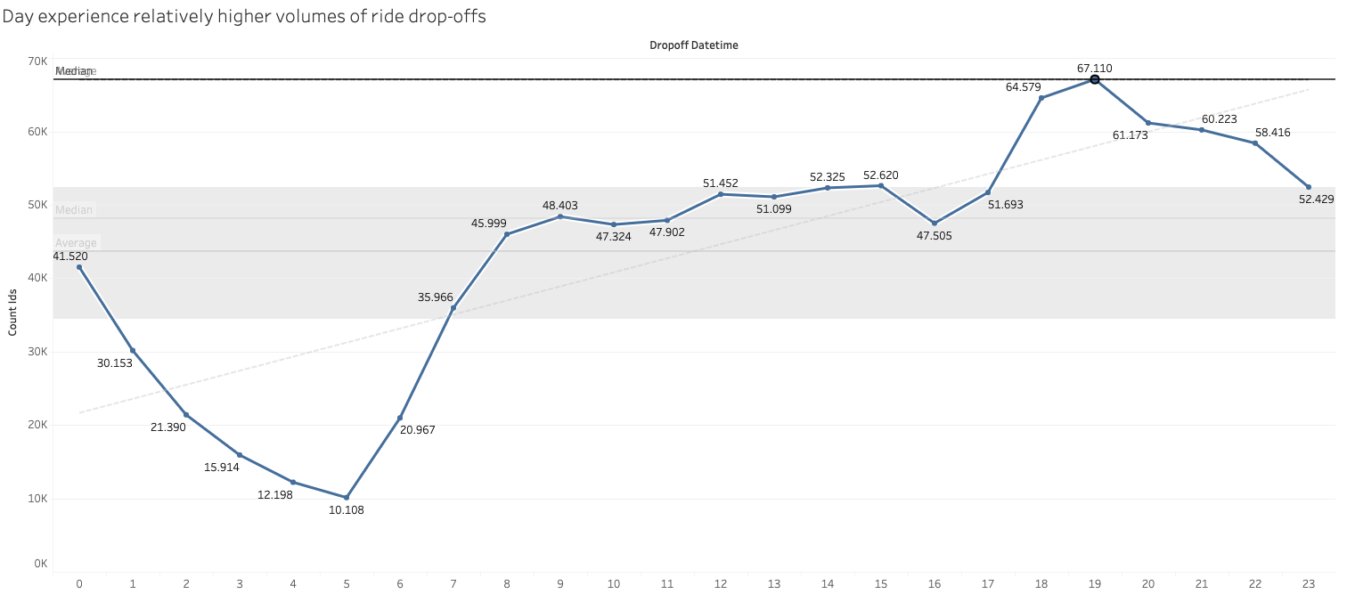
Answer Slide
What times throughout the day experience relatively higher volumes of ride pick-ups? From the analysis carried out it can be seen that there is a high incidence during the morning, rush hour, remaining the same during the afternoon and with an increase at the end of the day, after working hours ( 6pm to 8pm) -> High: 5pm - 10pm Mid: 8am - 3pm and Low: 1am - 6am.
High: 5pm - 10pm EST Mid: 8am - 3pm EST Low: 1am - 6am EST

Slide 44
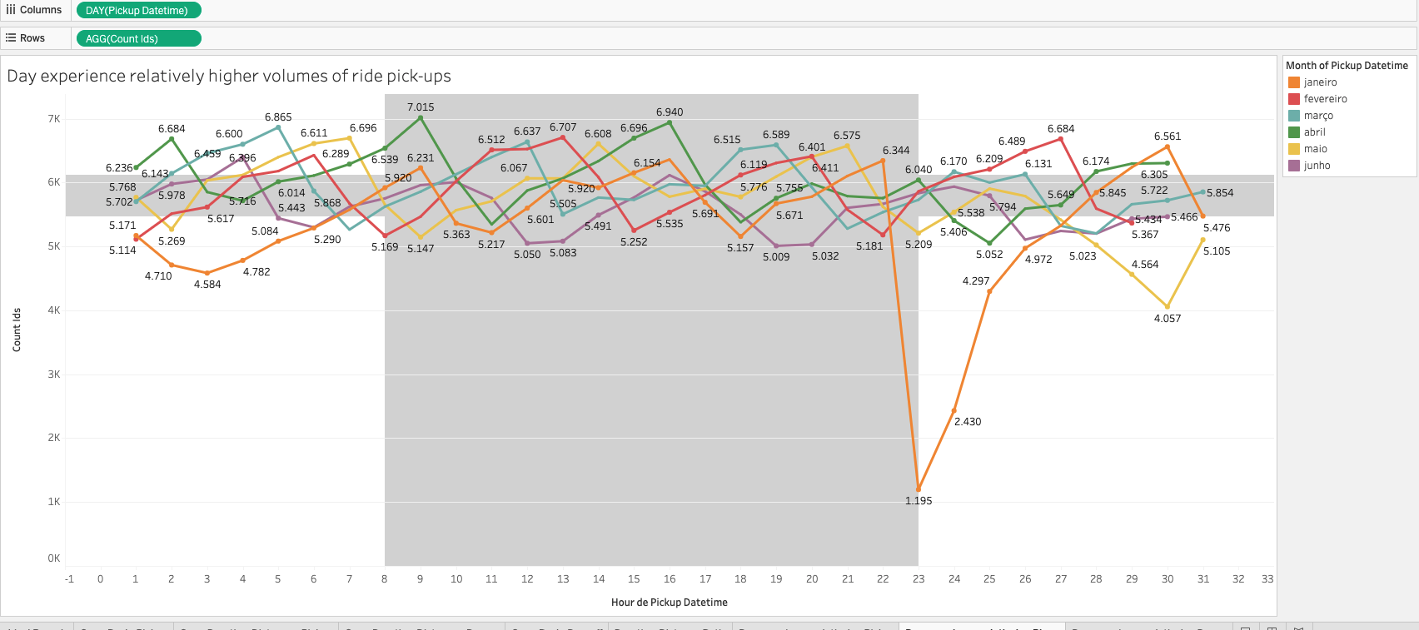
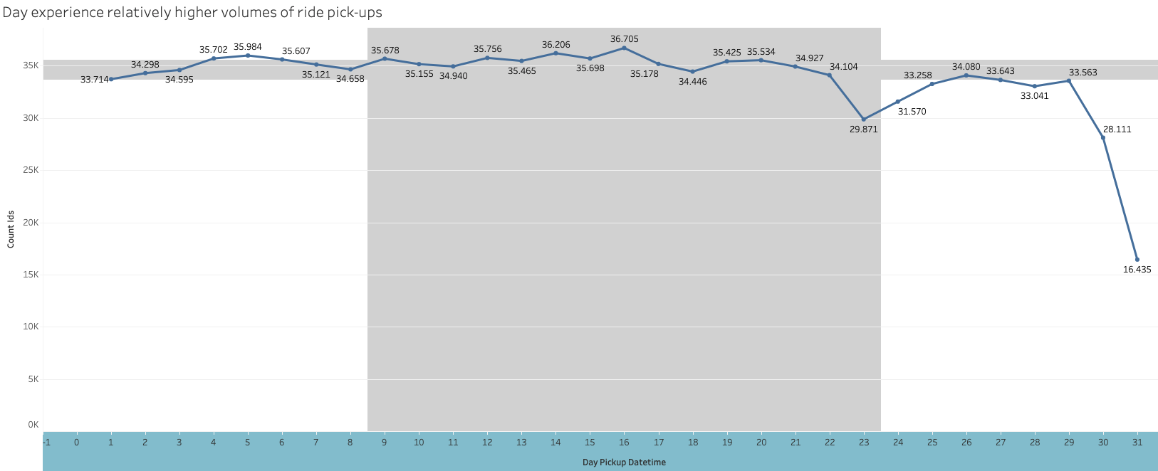
Answer Slide
What days throughout the week experience relatively higher volumes of ride pick-ups?

Slide 45
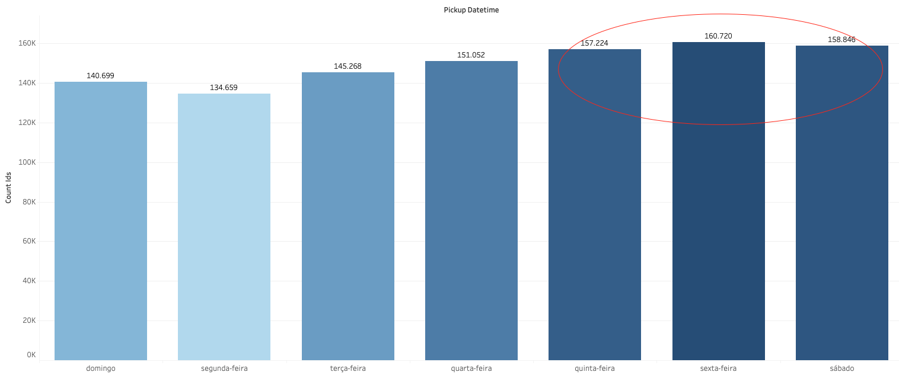
Answer Slide
Through the above analysis I can see that there is a great incidence mainly at the beginning and middle of the month. On a weekly level, it is clear that Thursdays, Fridays and Saturdays are the “best #trip days” of the week in terms of passenger pick-ups. In terms duration-to-distance ratio Saturday is the best.

Slide 46
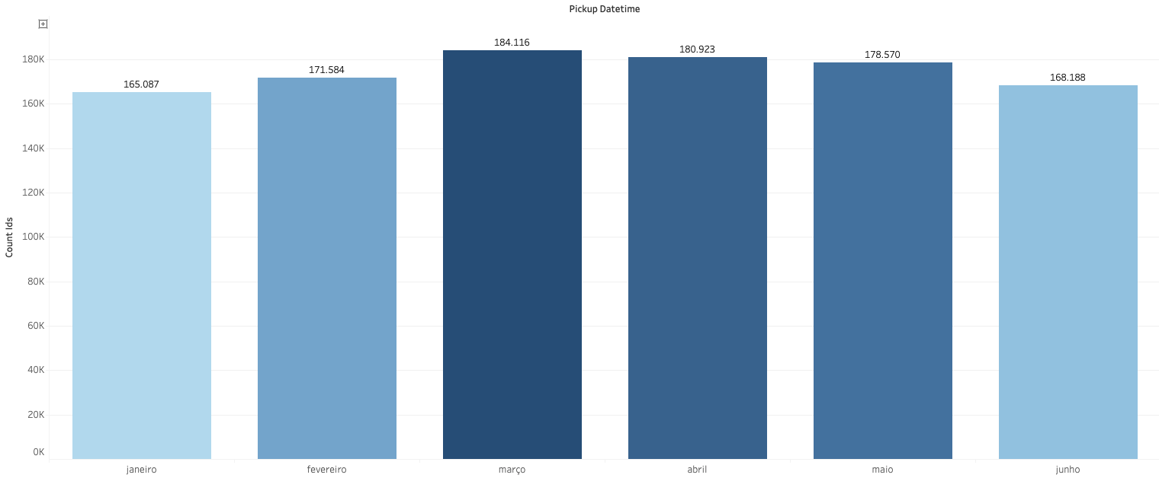
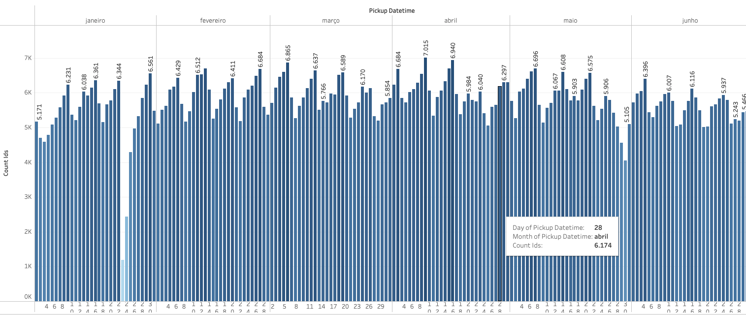
Answer Slide
Pinpoint any periods throughout the year that experience trend fluctuation or seasonality around ride pick-up volumes. This will help us in our post-launch analyses to determine if any spikes or dips were influenced by seasonality or through actual feature adoption/regression. There seems to be a huge decrease in demand during the 3rd week of January, as well as a slight decrease during the last week of May. February, March and April show a more constant level of demand. March & April are around 7% higher than the other months
Tableau VIZ

Slide 47
You and the user research team ran a quantitative survey on existing taxi and/or rideshare users in New York City to determine sentiment around potentially using a flying taxi service.
Dive into the survey results dataset in order to extract insights from explicit feedback.
Upload this dataset into Tableau Online or a SQL database (the classroom contains a workspace with the data for you as well).

Slide 48
Ensure the fields are parsed correctly, field headers are included in the first row of the CSV.
Question schema:
Q1 - What is your email?
Q2 - What gender do you identify as?
Q3 - What is your age?
Q4 - What is your annual income? (income bands)
Q5 - What neighborhood do you reside in?
Q6 - Do you currently use taxis? (Y/N)
Q7 - Do you currently use ridesharing services? (Y/N)
Q8 - Would you use a flying taxi service, if such a concept existed? (Y/N)
Q9 - If yes to Q8, how much would you be willing to pay per mile for such a service? (USD)
Q10 - If no to Q8, what is the reason?

Slide 49
Answer Slide
Global Analysis - 400 uses taxis and 99 doesn’t use. 80% of the respondents use taxis - For F and M gender, the avg yearly income is within the 40-80k - 41% never used ride-sharing services - ~45% of those who said no they will never use flying taxis, most have mentioned that it was related to ‘safety & security’ TABLEAU VIZ

Slide 50
To inform our future product marketing efforts, we’ll want to extract the following:
Is there an inclination of better Flyber adoption based on gender, age, income level, or neighborhood of residence?
What is the distribution of potential price per mile based on gender, age, income level, and neighborhood of residence?
What is the different personas/segments of negative sentiment towards not using a flying taxi car service?

Slide 51
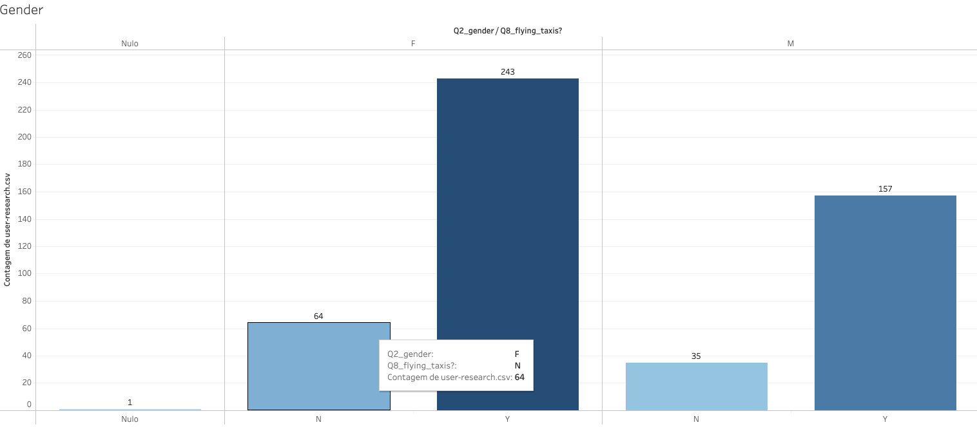
Answer Slide
Is there an inclination of better Flyber adoption based on gender?
Male: 157 yes (82%)
Female: 243 yes (79%)

Slide 52
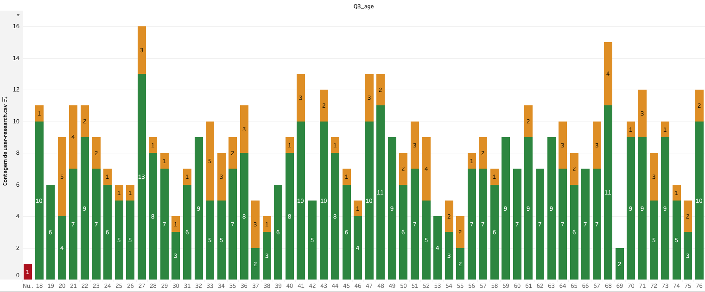
Answer Slide
Is there an inclination of better Flyber adoption based onage?
The biggest surprise is that there is a uniform pattern across all age groups, including the older age group of the interviewed population.

Slide 53
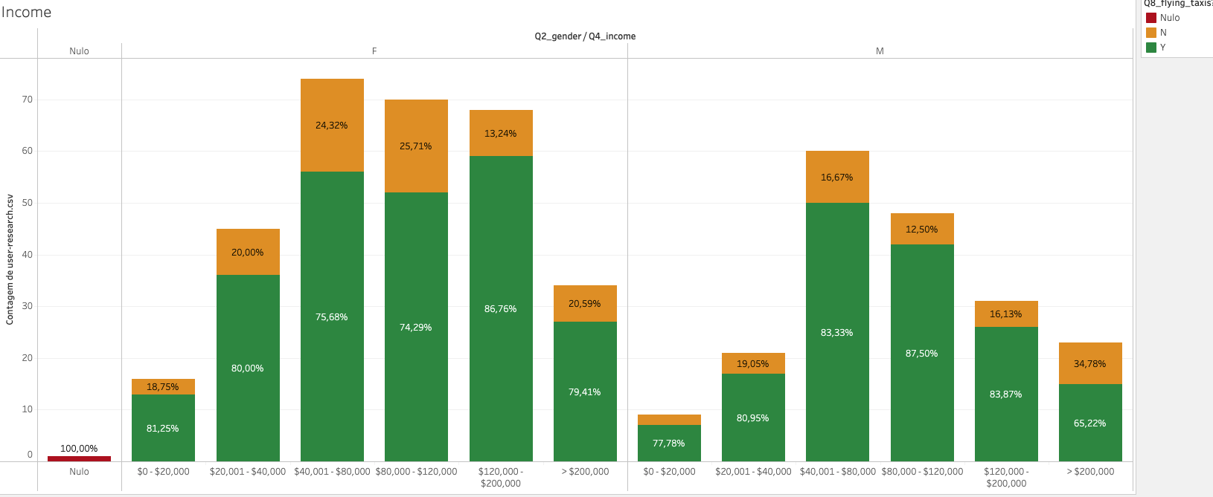
Answer Slide
Is there an inclination of better Flyber adoption based on income level?
For gender F $120k-200k income range is more open to flying taxis
For gender M $40k-80k income range is more open to flying taxis

Slide 54
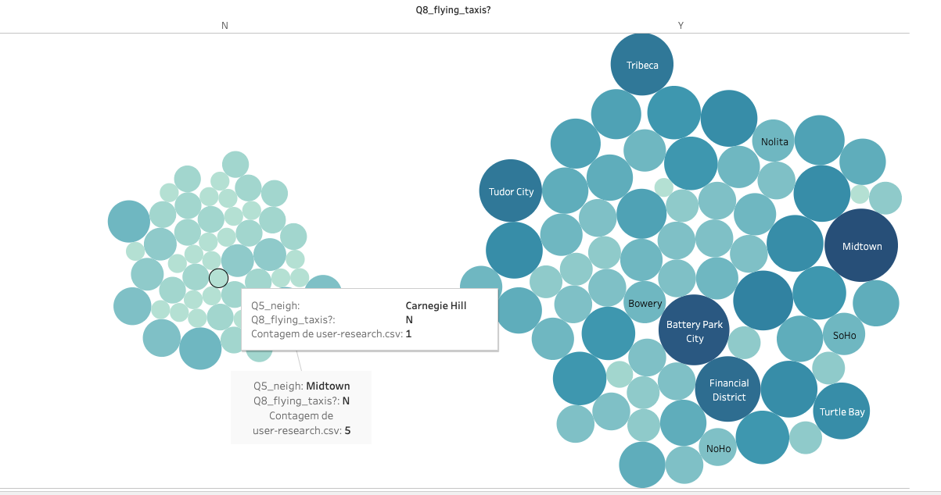
Answer Slide
Is there an inclination of better Flyber adoption based on neighborhood of residence?
The image gives an overview of the diversity in the neighbourhoods in which respondents live. The highest number lives in Midtown with 15. Then in second place are: Battery Park 14 and Financial District 12.

Slide 55
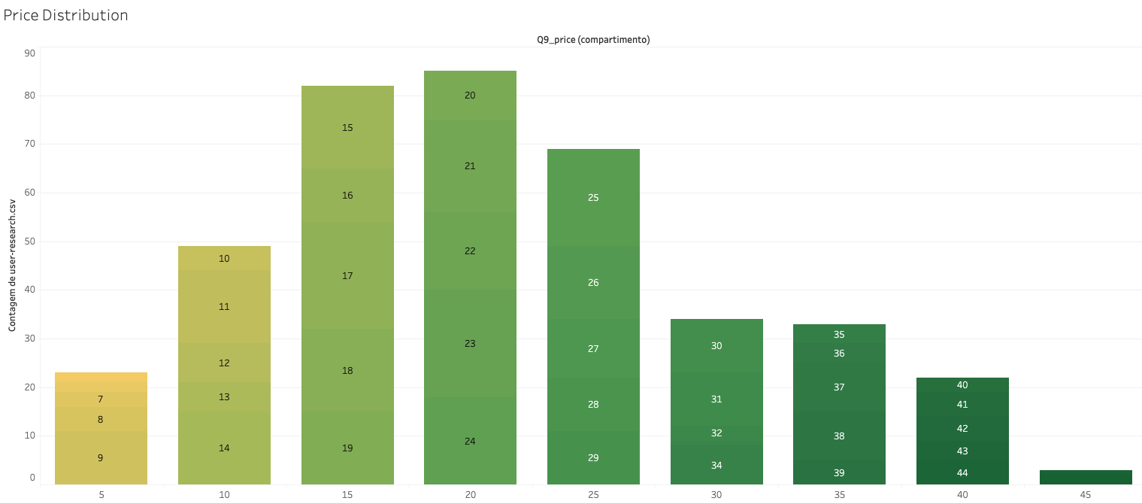
Answer Slide
What is the distribution of potential price per mile (overview)?
Price distribution: $20-$25
The highest price incidence is between:.
But it can be assumed that roughly 45% of respondents are looking to pay between 15-25

Slide 56
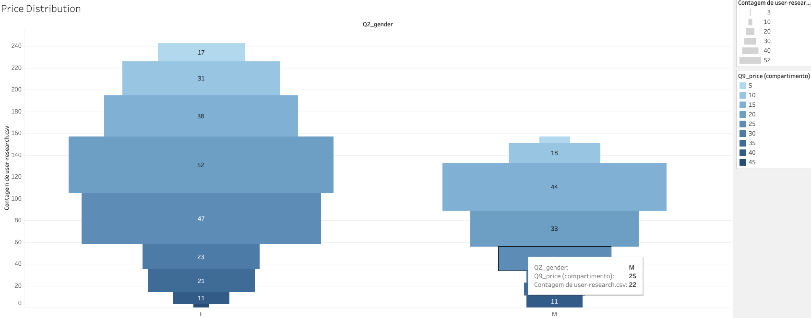
Answer Slide
What is the distribution of potential price per mile based on gender?
Female are willing to pay more, there is a high incidence on intermediate prices.

Slide 57
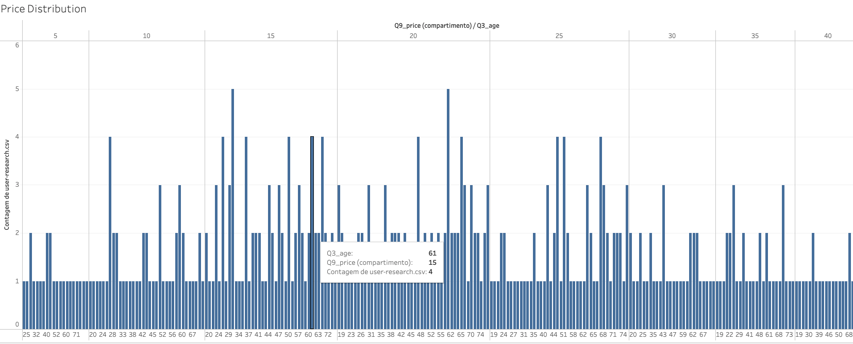
Answer Slide
What is the distribution of potential price per mile based on age?

Slide 58
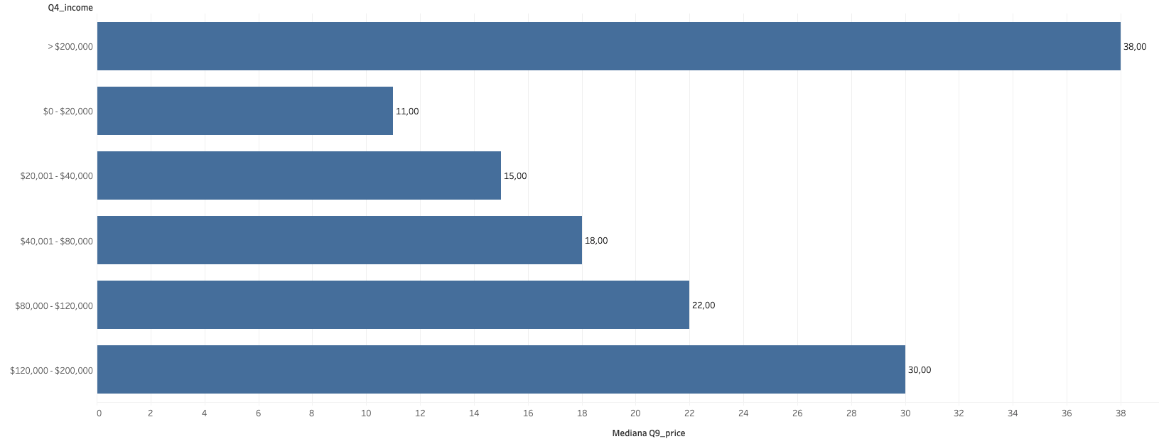
Answer Slide
What is the distribution of potential price per mile based on income?
It is clear that those who have more income do not mind paying more.

Slide 59
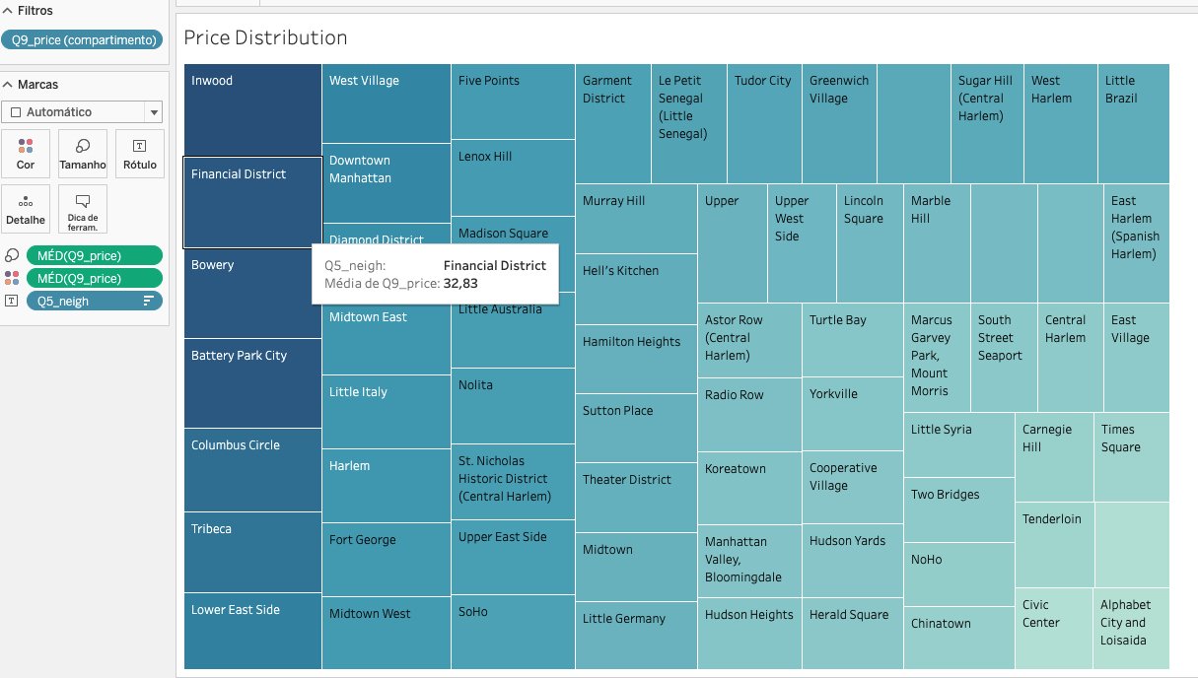
Answer Slide
What is the distribution of potential price per mile based on neighborhood?

Slide 60
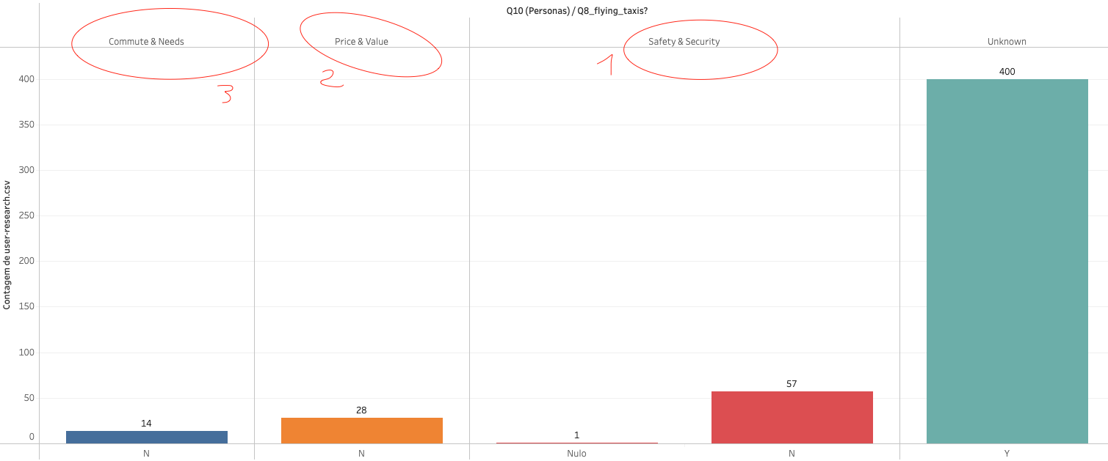
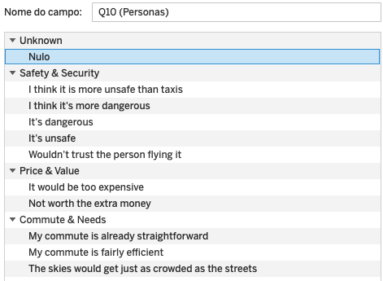
Answer Slide
What is the different personas/segments of negative sentiment towards not using a flying taxi car service?
Based on the answers to question 10, I defined the possible customer segments / personas based on the sentiment and characteristics of the answers. In this way I can confirm that the people who answered that they no use a taxi, are less confident in riding a flying taxi.
For them the question of safety is crucial.
Next, are the people who do not want to ride for economic reasons and last but not least, the question of necessity and convenience.
Overall 400 people respond that they want to experience this, with 81% of the respondents, it has a great impact.

Slide 61
Answer Slide
Conclusions: Based on the various analyses I have done, I can confirm at this stage that there is no specific target audience or market segment that flying taxis should be turning to. Although I did find some interesting insights, in terms of the feelings of the users interviewed. Overall, there is an even distribution across gender, place of residence, age group and annual income. In terms of real data, based on Taxicab, we see that there is an incidence of demand at the end of the weeks, at specific times, this may help to make some decisions in the next stages of the project. I would like to say that the only thing that really stands out from the results of the questionnaires, is that a percentage of the users show concerns in terms of security and reliability of the service, as well as concerns with the price of the service.

Slide 62
Hooray! End of Section 1.

Slide 63
You will complete Section 2 at the end of this course.
Please submit this file for review for Section 1.

Slide 64
Section 2: Proposal Synthesis

Slide 65
Answer Slide
The Proposal Synthesis was developed based on the research and analysis done earlier in chapter 1 (part 1) of this document. In addition, the contents of the Udacity sessions and the methodologies presented are used. Based on the documentation, the knowledge acquired, the analyses performed and the bibliographical survey carried out, a Proposal Synthesis for the Flaying Taxis product is presented. Note: At a certain point I started to consider the impact of the pandemic COVID 19 in the decisions, considering it as a risk for the success of the product. Note: I take the users of our product, as being users, customers or consumers, depending on the context of the sentence. User when we talk about apps, customer and or consumer when we talk about making the journey.

Slide 66
Answer Slide
Referencies: [1] - https://thetool.io/2019/mobile-user-strategies-acquisition-retention#User_Acquisition [2] - https://clevertap.com/blog/smart-user-acquisition-starts-with-user-retention/
[3] - https://blog.hubspot.com/marketing/marketing-key-performance-indicators [4] - https://www.productmanagementexercises.com/569/how-would-you-acquire-more-users-for-uber [5] - https://clearbridgemobile.com/5-methods-for-increasing-app-engagement-user-retention/ [6] - https://applift.com/blog/are-you-tracking-these-kpis-in-your-user-acquisition-strategy [6] - https://www.klipfolio.com/resources/kpi-examples/sales/customer-acquisition

Slide 67
Identify a product objective for Flyber's launch. Your product objective will guide your KPIs, so identify what Flyber should optimize for. Your objective should be centered around one the following focus areas:
User Acquisition
User Engagement
User Retention
Profitability
Explain your reasoning. Include both why you feel your focus area is more relevant than the others for Flyber at this time of the product development cycle.

Slide 68
Answer Slide
Area: User Acquisition User acquisition is the process of bringing new users or clients into our business. The goal of this process is to create a systematic and sustainable acquisition strategy that can evolve with new trends and changes.
As this is an important step in launching a product on the market, and considering that the Flyber is a new business, to be launched on the market, and that they do not have any type of acquired customers (only intentions based on research surveys), I believe that this is an area of great impact for the success of this product.

Slide 69
Answer Slide
Goals sample for User Acquisition : -> Goal 1 (GUA01): Users gain brand and service awareness -> Goal 2 (GUA02): Users consider our product in their consideration pool -> Goal 3 (GUA03): Users make the decision to use the service and to be a paying user of our product

Slide 70
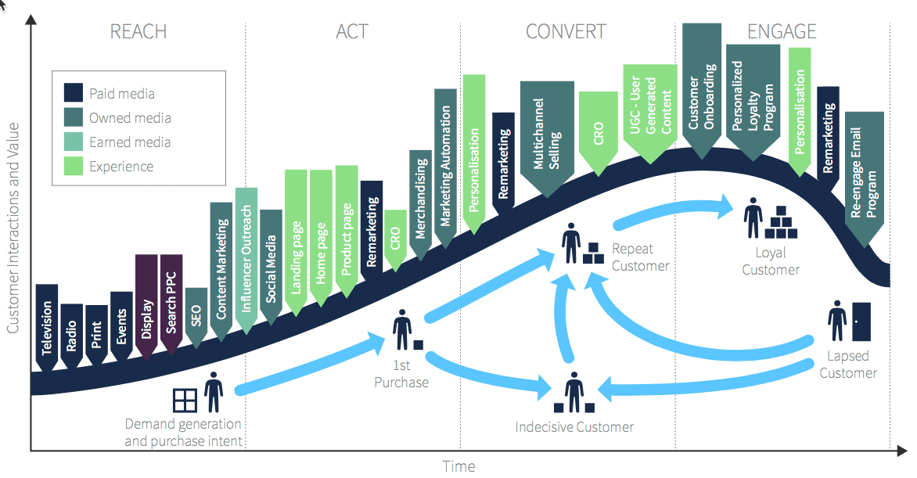
Answer Slide
GUA01 - Users gain brand and service awareness
GUA01: Users gain brand and service awareness ->
It is evident in the literature and based on common sense that having a brand that is known, solid in the market and respectable for its service is halfway to attracting and acquiring new customers.
When a product is launched, there should be a big bet and investment in markting campains, advertising and the brand in several channels, such as media, radio, among others.
Source: https://www.smartinsights.com/traffic-building-strategy/campaign-planning/structure-product-launch-campaign/

Slide 71
Formulate 3-5 Key Performance Indicators (KPIs), to measure if the product is heading towards the right direction based on your objective

Slide 72
Answer Slide
KPI’s for GUA01 - Users gain brand and service awareness
-> GUA01-KPI1 - Customer Acquisition Cost (CAC)
-> GUA01-KPI2 - Active Users: Daily & Monthly Active Users (DAU & MAU)
-> GUA01-KPI3 - Conversion Rate (CR) / App Store Optimization (ASO)
-> GUA01-KPI4 - Average Referral Count (ARC)

Slide 73
Answer Slide
GUA01 - GUA01-KPI1 - Customer Acquisition Cost (CAC) (part 1)
CAC is one of the most important metrics a startup can use. Here is a detailed guide to help you leverage it. Is the cost associated in convincing a customer to use our service.
So, as Flyber wants to launch itself in the market, it has to get customers and to make itself known and convert them to use its services, it is important to advertise the product in different communication channels. To do this there will have to be an initial investment in the first 6 - 9 months of the year in advertising and brand awareness. To make this happen there are also costs for marketing personnel, fees to be paid to communication partners and other costs related to tools and rights. With this work the brand will be known and customers will use the service.
Any reduction in customer acquisition costs increases profit margins, so tracking this KPI over time will be of high importance.
CAC is also a valid metric for companies entering markets, and is often used to analyse product scalability. Track customer acquisition costs in each of the marketing channels?
In this way you can identify which channels have the lowest overall acquisition costs and highest conversion levels, and focus efforts there.
It is also important to have mechanisms in place to understand how customers are reaching us.

Slide 74
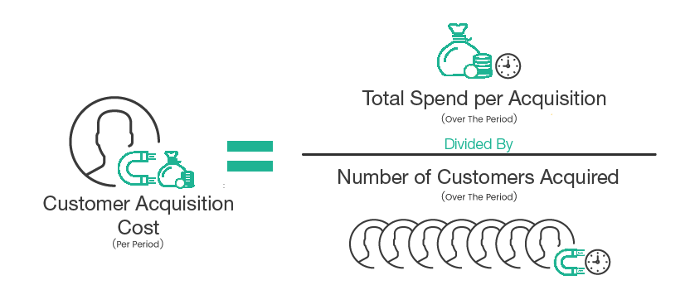
Answer Slide
GUA01 - GUA01-KPI1 - Customer Acquisition Cost (CAC) (part 2)
As it is still complicated due to lack of information to assess costs, we want to consider that per month we have a available amount to spend on marketing.
Assumptions:
Total Spend per Month: markting and advertising: 15.000$; salary: 10.000$ (2 people); tools: 1000$
Thus, per month we have a cost of 26.000$.
In the first 6 months we have a cost of 6*26.000$, which we want to convert into 10.000 customers.
This scenario has a CAC of 15.6$.
At the end of the 9 months we want 13.000 customers. By the end of 12 months, we want 20.000 customers, drastically reducing advertising costs and assuming that referrals are a strong means of attracting, converting, and continuously using the services. We therefore seek to measure this number with other KPIs presented below.
How do you measure CAC?
In simple terms, I can calculate your CAC by dividing total acquisition spend (sales and marketing costs) in any given period by the number of customers gained in that same period:
Source: https://five23.io/blog/knowing-your-customer-acquisition-cost/

Slide 75
Answer Slide
GUA01-KPI2 - Active Users: Daily & Monthly Active Users (DAU & MAU & ADAU)
This KPI, or set of metrics that allows us to calculate and measure the number of customers, is very important to measure the impact of our service and how much we are able to convert users, either through the strong investment we made in marketing, either by the strong possibility of providing a service of excellence and the highest referrals. Now we should mention that the core of the service provided is a taxi trip, but no less important is only possible through the use of technology, in this case specifically an APP for smartphone and the web site (Desktop or Mobile).
Roughly speaking, this metric will allow us to measure customer traction through active users on our platforms. And when these metrics show growth, it means that the app or site is getting more traction. This metric will be analysed over different time periods:
-> MAU - the number of users using the app in a particular month. Target for DAU: 700
-> DAU - the number of users using the app on a particular day. Target for MAU: 2000
Thus, it is intended that in the first 6 months there will be 10,000 customers.
And finally we get another metric based on MAU and DAU:
-> DAU/MAU is a popular metric for customer engagement - it's the ratio of your daily active users over your monthly active users, expressed as a percentage.
DAU/MAU = 700/2000 = 0,35 = 35% - The ratio of 35% basically means that the average customer of our service uses it 10 days out of 30. If it is < 1% it means that all new customers only try our service once and do not return.

Slide 76
Answer Slide
GUA01-KPI3 - Conversion Rate (CR) / App Store Optimization (ASO)
Visibility of the brand and the service provided (how and what^) is key to user acquisition. From the analysis performed, it is known that there are more than 1 Million applications in the stores and that they are all fighting for users' attention, so it is very difficult for a new application to have visibility and stand out.
Since the core of our service is a mobile application, it is important to define strategies for our application to have high visibility in online app stores.
The visibility in app stores is based mainly on Search, Top Charts and Featured.
Based on this benchmark identify me KPI's to track visibility and discoverability in app stores:
- App keyword rankings – This involves tracking how well we rank for a list of relevant keywords.
- Top charts rankings – Where do you rank in the top charts? I’ll need to monitor both the paid and unpaid rankings.
- Category rankings – Where does our app rank in its specific category?
So in the first 3 months we aim for 10,000 downloads, in the first 6 months we aim for 100,000 downloads, 9 months we aim for 600,000 downloads, and in 12 months we aim for 1.5 Million downloads.
Source: https://applift.com/blog/are-you-tracking-these-kpis-in-your-user-acquisition-strategy

Slide 77
Answer Slide
GUA01-KPI4 - Average Referral Count (ARC)
Based on the relationship between KPI, and the relationship between user behaviours, it is important to realize that referrals are an important means of acquiring new customers.
Several approaches can be adopted, like other brands, we can offer a symbolic value to those who through the App make a referral for installation and use to friends or family. Thus, it is believed that this measure will directly affect the number of downloads, usage, DAU and MAU, and also lead new users to come forward and try our service.
Therefore, the number of referrals from clients is expected mainly within the first 6 to 9 months, and it is believed that this growth in the number of referrals will happen every time a customer uses our service and has a good experience.
The number of referrals is expected to increase after the 6th month, and an average of 5 referrals from 1 customer who has an entire successful trip.

Slide 78
Create hypotheses around what thresholds your KPIs would need to hit in order to determine success

Slide 79
Answer Slide
-> GUA01-KPI1-H1 – With the investment in Marketing, gradually choosing to reduce costs as the conversion of customers takes place, it’s possible to halve the marketing campaign in the second half of the year and keeping the focus on referrals, it is possible to reduce costs by 30%, but ensuring that the number of DAU and MAU, referrals and conversions continue to grow. -> GUA01-KPI2-H1 – Based on the investment in marketing, and complementing it with awareness and the addition of safety and convenience features, it can have a positive impact on the users' doubts, and consequently through the reduction of fear, it is expected that the ratio of UAD and MAU will grow between 5% and 10%. -> GUA01-KPI3-H1 - Betting on a more precise work in the allocation of the app in the stores with adequate descriptions, making it appear in the rankings of the respective categories, is a chance to considerably increase by 15% the number of downloads and the conversion ratio. -> GUA01-KPI4-H1 - Adding a sharing and referral feature through the app with the possibility to receive a symbolic amount of $ to spend on a next trip, the hypotheses I have is that there will be an increase in referrals after the 6th month of use, and an approximate average of 5 referrals per costumer with a successful trip is expected.

Slide 80
As the product manager, you make decisions based on the insights you extract, we’ll need to know the feature set we’ll include in the MVP to measure viability, while keeping operational expenditure under control:
What times/days of operation should the service run for?
How many pick-up / drop-off nodes should we have?
Where should the nodes be located?
Should we initially use copters or homegrown hardware?
Should the pricing be fixed or dynamic? At what rates?

Slide 81
Answer Slide What days of operation should the service run for?
Through the above analysis I can see that there is a great incidence mainly at the beginning and middle of the month. On a weekly level, it is clear that Thursdays, Fridays and Saturdays are the “best #trip days” of the week in terms of passenger pick-ups. In terms duration-to-distance ratio Saturday is the best.

Slide 82
Answer Slide What times of operation should the service run for?
From the analysis carried out it can be seen that there is a high incidence during the morning, rush hour, remaining the same during the afternoon and with an increase at the end of the day, after working hours (6pm to 8pm) High: 5pm - 10pm Mid: 8am - 3pm and Low: 1am - 6am. Conclusion: The service should focus for these time windows (High and Mid), everyday.

Slide 83
Answer Slide How many pick-up / drop-off nodes should we have? Where should the nodes be located?
Using the analysis made before (taxis data and survey data), I suggest the use and adaptation in 3 central nodes (a centre like Hell's Kitchen, a north like Yorkville and a south like Tribeca). As well as 3 node to cover JFK and LaGuardia.

Slide 84
Answer Slide Should we initially use copters or homegrown hardware?
Considering the various hypotheses that we have, I suggest investing a little more in research on this subject either at the level of auto, motors, aeroplanes, metals, electricity since the services similar to ours do not provide precise data on the service we want to provide. However, the plan is to certainly enter the market focusing on the first users that want to try our service, also guaranteeing the best possible experience through specialized and customized hardware according to their needs.

Slide 85
Answer Slide Should the pricing be fixed or dynamic? At what rates? (part 1)
Based on the previous analysis done, and knowing that the service is in the MVP stage, it is extremely important to ensure that the pricing or monetization is aligned with the entire life cycle of the product. That is, in a first phase the price should be fixed and lower, without major fluctuations for users. This is because our major goal at this stage is to get users to install our platform, and have them use it to make travel bookings, in other words. Ensuring an excellent, safe and compliant flight experience is essential to make the price set fair. At this stage it is also important to define the user segment we want to target, depending on the price we set for each trip. It is important to point out that we considered the variables duration in seconds and distance in km. So based on the information obtained, we consider that - The basic fee is $2.50, the kilometer price is $1.56. For standing and waiting time, $30.00 is charged per hour. So, the calculation formula is as follows (ignore waiting times per hour): Price = Base fee + (Cost per minute * time in ride) + (Cost per km * ride distance/0.6214)
 | Average | Median | First standard deviation of the mean | Second standard deviation of the mean
Price ($ dolars) | 19,1 | 13,5 | 29,7 | 59.5

Slide 86
Answer Slide Should the pricing be fixed or dynamic? At what rates? (part 2)
Based on the above calculation, it is important that at the start the price is actually fixed, to ensure that the target audience is at a high level of familiarization with the services provided and with pricing at the beginning. The form to consider is the one I presented above. Considering also the analysis done previously on the research data, we can set the target at 25$ (considering that the trips are long distances, well over 5 miles).

Slide 87
Determine the MVP sample size & time period allotted estimated to come to a conclusion on your hypotheses.

Slide 88
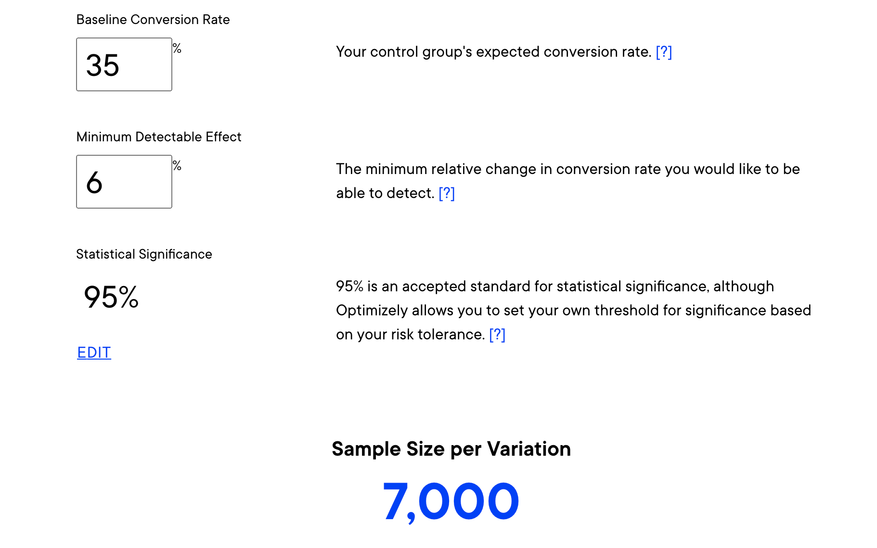
Answer Slide
The sample size (qualitative survey and taxi cab and NYC data) is enough to return us several insights either numerical or spatial. Based on this data we were able to understand and identify the target audiences.
Using Optimizely’s A/B Test Sample Size Calculator A/B Sample Size Calculator
Assuming the KPIs that have been defined we can experiment within the scope of the DAU / MAU ratio that has been defined to be 35% in the first 6 months. The estimated time period for this entire experiment would be 2 months. That would be 60+ days.
The above data shows the possibility within our sample size, showing a base conversion rate of 35% for the ratio of DAU/MAU, having 6% probable detectable effect.
Our sample size here is 7.000.

Slide 89
Create an instrumentation plan for the events you need collected and logged, in order to be able to physically measure your KPIs.

Slide 90
Answer Slide
Event: User_Trip Definition: This event allows to identify when a user schedules a trip via app/desktop, it identifies the beginning and the end of the trip. Properties: ride_id , user_id, timestamp_pickup, timestamp_drop, price, distance, duration, driver, plan_info, longitude, latitude, ... Event: Cancelled_Trips Definition: This event allows to record which of all scheduled trips have been canceled just before they start (approximately in the next 3 minutes). Average waiting time is expected to be between 5 to 7 minutes. Properties: ride_id , User_id, timestamp, cancelled_type, ... Event: Referred_Users Definition: This event allows to track the users that have installed the app, by referencing another user by sending the link via app/desktop. Properties: user_id, refer_user_Id, timestamp_sent, timestamp_install, timestamp_first_login, version_app, channel, platform, ... Event: App_logins Definition: This event allows to identify all users who have installed the app, as well as the platform they are using. Allows for a detailed measurement of the conversion rate. Properties - user_id, app_id, version, timestamp_last_login, timestamp_first_login, platform, ...

Slide 91
Create a qualitative feedback survey questions for users after their ride, to further understand and optimize the product for future iterations.

Slide 92
Answer Slide
Qualitative feedback survey questions for users after their ride [Header] [Survey Presentation and Description] [Question 1] - Did you enjoy the experience? [Question 2] - Based on your answer, in three words tell us why? [Question 3] - Did you feel safe during the trip? If not, please justify and share what you would like to see differently? [Question 4] - During the trip did you feel comfortable with all the amenities? If not, please justify and share what you would like to see differently? [Question 5] - Do you think the length of the trip was worth it compared to other alternatives? Before using our service did you consider using other alternatives? [Question 6] - For booking the trip did you use the app or desktop? [Question 7] - Did you find the App or Desktop easy to use? What would you like to see improved? [Question 8] - Which features of our service did you like the most? [Question 9] Would you recommend our service to other people? Could you please justify? [Farewell]
Through the app, it will also be possible for the user to rate the trip itself. In addition, the user can also respond to the survey that allows the measurement of two indicators that serve as a barometer of the customer such as NPS, CSAT and CES.

Slide 93
Summarize everything you have learned into your final proposal
Identify the target population. Why did you select that target population? What are their pain points?
Create a product proposal containing claim, evidence, estimated impact, and risks
Claims should be backed by quantitative evidence, impact should assess market needs/benefits
Risks involve any known unknowns that we’ll still need to monitor post-launch
State cross-functional stakeholder teams that will need to be involved

Slide 94
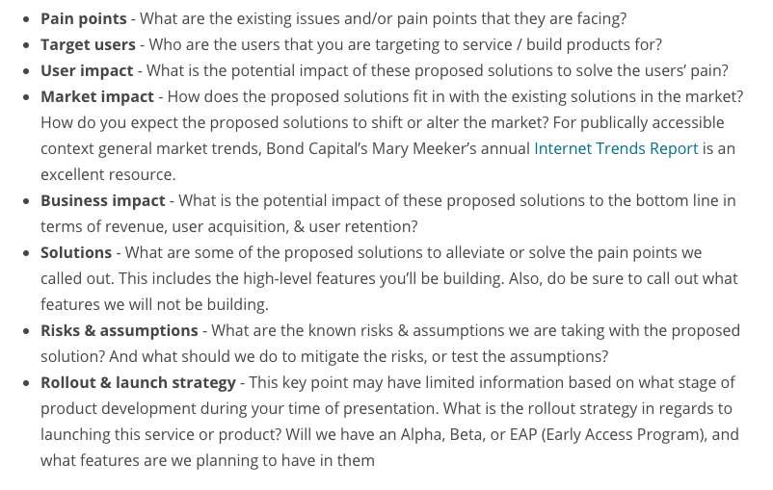
Answer Slide
Product Proposal

Slide 95
Answer Slide
Identify the target population. Why did you select that target population? What are their pain points? Target Population: We try to attract all kinds of costumers, but by analysis focus on those who are more open to these services, who have better financial conditions, >= 100.000 income, and who normally experience the problems of traffic for daily trips. And our clients have to know how to use the mobile phone or the web site. Pain Points: People are looking for fast, comfortable and safe ride. To do this, they try to avoid poor taxi-cab service, waiting time in traffic either due to congestion (avoiding rush hours) or road accidents.

Slide 96
Answer Slide
Create a product proposal containing claim, evidence, estimated impact, and risks (part 1)
Solutions: It is evident that NYC despite having several transportation options such as subway, cabs, uber, buses, ... still has serious problems when it comes to traffic, whether during rush hours or not. As I mentioned earlier, traffic accidents, congestion, delays, rush hours are a constant and a problem for those who use these services. People want to see this situation overcome once and for all, and here our flying cab service would be a completely new and innovative idea, and at the same time it would have an extremely important role and impact on society. Our service would overcome all of the above problems. User impact: The main impact on the user will be to increase overall consumer engagement, well being, safety and comfort and convenience, leading to overall satisfaction. Market impact: In addition to avoiding the problems that traditional transportation faces such as congestion, comfort, convenience, this service would raise the travel experience to a higher level, changing traditional habits and services. Business Impact: It’s too early to measure impact in terms of revenue, since we intend to enter the market with a large investment in marketing to promote the brand and our service. But with the solutions we try to get as many customers as possible, and with that we try to increase our revenue. We believe we will get a large number of customers in the first 6 months, and given the experience presented we will be able to retain users and convert them into daily users.

Slide 97
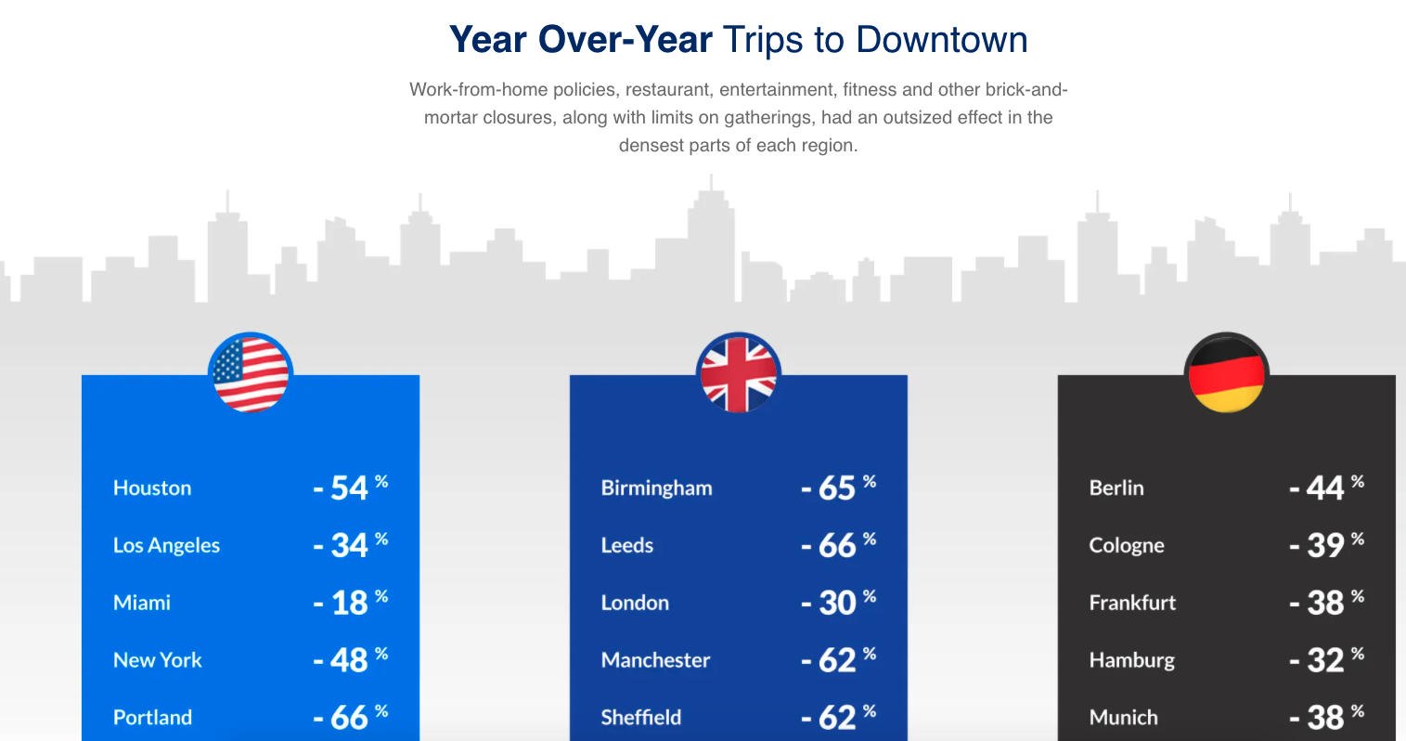
Answer Slide
Create a product proposal containing claim, evidence, estimated impact, and risks (part 2)
Risks and Assumptions:
The impact of the COVID 19 pandemic due to issues of isolation and restrictions on movement, as well as the impact of the home office. It leads to people not moving around as they used to, and therefore not seeking these types of services. It could have a negative impact on our service, if people opt for their own cars when they have to leave home. But the problem of transit may remain.
Safety of the means of transport and hardware engineering limitation, since it is based on small aircraft, we need a lot of research and development to ensure 100% safety for our customers,.
Legal issues such as licensing (flying certifications) of our service in the society, without impacting other air services, definitions of maximum altitudes, traffic, etc...
The human emotions factor is another risk that we may face in resisting new experiments, for fear of not knowing and for security reasons. In the survey carried out the users show concern for their safety.
Ensure that the drivers of our aircraft are reliable, certified, and medically fit persons, as verified by regular medical inspection.

Slide 98
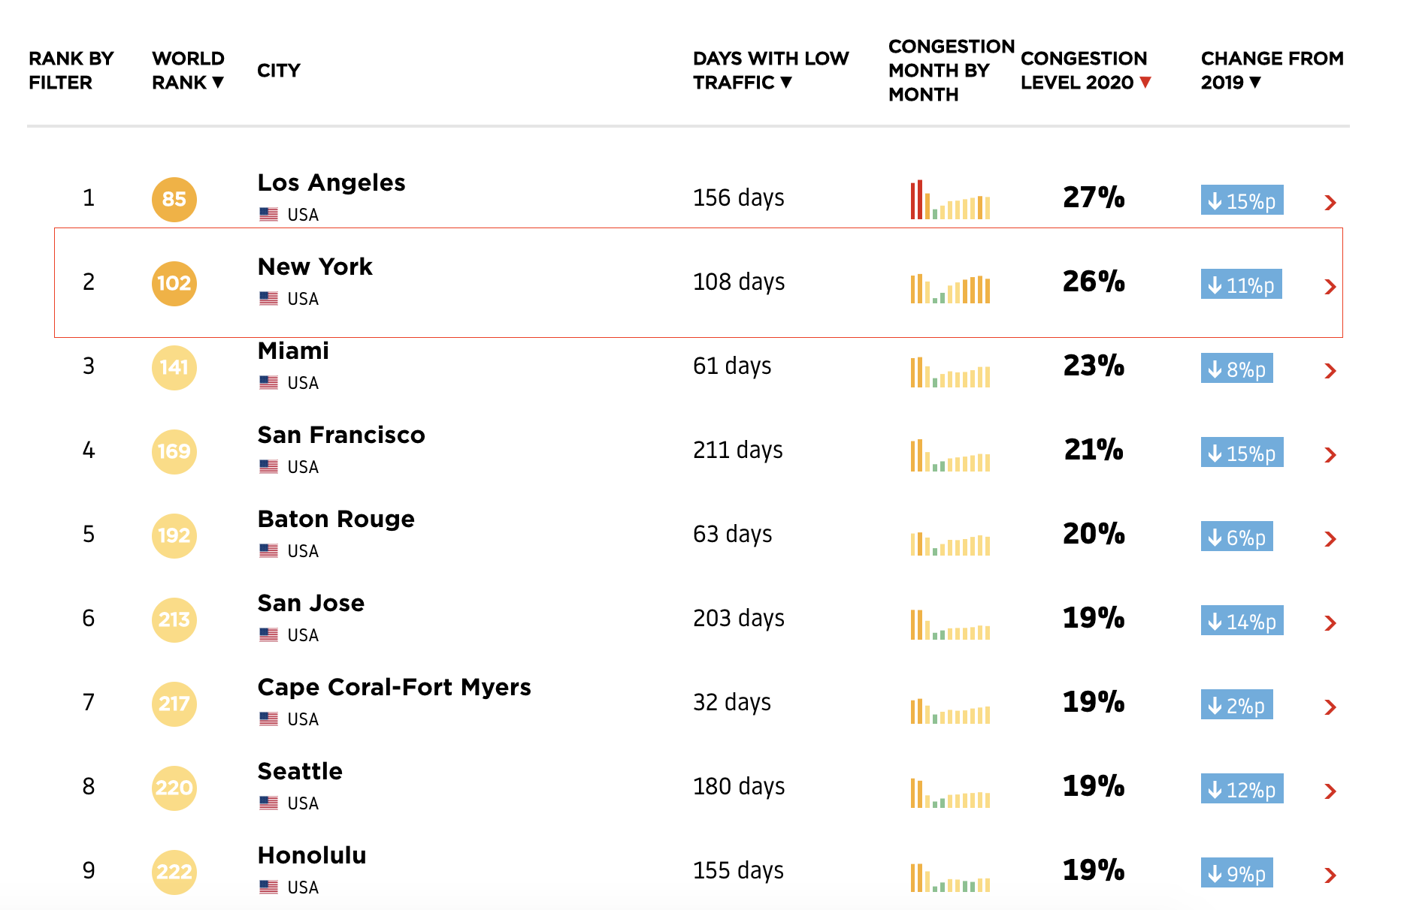
Answer Slide
https://ny.curbed.com/2018/1/18/16903152/nyc-traffic-congestion-cost-analysis
https://inrix.com/scorecard/
Source: https://www.tomtom.com/en_gb/traffic-index/ranking/?country=US

Slide 99
Answer Slide
Rollout & launch strategy - EAP program for early users - Referrals and reviews - Partnerships - A Loyalty program
Create a product proposal containing claim, evidence, estimated impact, and risks (part 3)
Source: https://hbswk.hbs.edu/item/how-uber-airbnb-and-etsy-attracted-their-first-1-000-customers
Source: https://www.annexcloud.com/blog/ubers-marketing-strategy-in-7-steps-revisited/

Slide 100
Answer Slide
State cross-functional stakeholder teams that will need to be involved 1. Legal and Privacy Department – certifications, regulations, terms-of-use, gdpr, … 2. Marketing & Business Department– advertiseng, go-to-market, campaigns, publicity, important for a successful MVP, … 3. Product Department – manage, business studies, risks, … 4. Accounting Department – revenue, scorecard, profit, reports, … 5. Product and Research Departments – User Research, Product Design, Software Design, CX, UX, … 6. Engineering Departments - Software Eng, , Auto Eng, Elect. Eng, Mechanic Eng, … 7. Quality Department – testing software and hardware, … 7. Operations & Logistic Department – daily operations, fleet management, … 8. Analytics Department - Include Business Intelligence, Data Engineer, Data Science, with AI and ML, … 9. Human Resource Department – people management, drivers management, … 10. Business IT Department - IT infrastructure, Network Security, … 11. Strategy Department - defining strategies, evaluating market competition, scrapping, …

